Slide 1

Elementary aspects

Slide 2
Agenda:
What is Spark?
Features of Spark
Components of Spark
Apache Spark Architecture
Basic Spark commands

Slide 3
What is Spark?
Apache Spark is an open-source, distributed computing system designed for large-scale data processing and analytics. It was developed to address the limitations of the traditional Hadoop MapReduce model, providing a more versatile and efficient framework for big data applications. Spark is known for its speed, ease of use, and support for various workloads, including batch processing, iterative algorithms, interactive queries, and streaming.
To use Apache Spark, you typically write applications in Scala, Java, Python, or R. The Spark API is available in these languages, allowing developers to choose the language they are most comfortable with. Additionally, Spark provides interactive shells for Scala and Python, making it easy to experiment and prototype code.
In-Memory Processing
Resilient Distributed Datasets (RDD)

Slide 4
Features of Spark:
Fault tolerance
Dynamic In Nature
Lazy Evaluation
Real-Time Stream Processing
Speed
Reusability
Advanced Analytics
In Memory Computing
Supporting Multiple languages
Integrated with Hadoop
Cost efficient

Slide 5
Features
Fault Tolerance: Apache Spark is designed to handle worker node failures. It achieves this fault tolerance by using DAG and RDD (Resilient Distributed Datasets). DAG contains the lineage of all the transformations and actions needed to complete a task. So in the event of a worker node failure, the same results can be achieved by rerunning the steps from the existing DAG.
Dynamic nature: Spark offers over 80 high-level operators that make it easy to build parallel apps.
Lazy Evaluation: Spark does not evaluate any transformation immediately. All the transformations are lazily evaluated. The transformations are added to the DAG and the final computation or results are available only when actions are called. This gives Spark the ability to make optimization decisions, as all the transformations become visible to the Spark engine before performing any action.
Real Time Stream Processing: Spark Streaming brings Apache Spark's language-integrated API to stream processing, letting you write streaming jobs the same way you write batch jobs.
Speed: Spark enables applications running on Hadoop to run up to 100x faster in memory and up to 10x faster on disk. Spark achieves this by minimizing disk read/write operations for intermediate results. It stores in memory and performs disk operations only when essential. Spark achieves this using DAG, query optimizer and highly optimized physical execution engine.

Slide 6
Features
Reusability: Spark code can be used for batch-processing, joining streaming data against historical data as well as running ad-hoc queries on streaming state.
Advanced Analytics: Apache Spark has rapidly become the defactor standard for big data processing and data sciences across multiple industries. Spark provides both machine learning and graph processing libraries, which companies across sectors leverage to tackle complex problems. And all this is easily done using the power of Spark and highly scalable clustered computers. Databricks provides an Advanced Analytics platform with Spark.
In Memory Computing: Unlike Hadoop MapReduce, Apache Spark is capable of processing tasks in memory and it is not required to write back intermediate results to the disk. This feature gives massive speed to Spark processing. Over and above this, Spark is also capable of caching the intermediate results so that it can be reused in the next iteration. This gives Spark added performance boost for any iterative and repetitive processes, where results in one step can be used later, or there is a common dataset which can be used across multiple tasks.

Slide 7
Features
Supporting Multiple languages: Spark comes inbuilt with multi-language support. It has most of the APIs available in Java, Scala, Python and R. Also, there are advanced features available with R language for data analytics. Also, Spark comes with SparkSQL which has an SQL like feature. SQL developers find it therefore very easy to use, and the learning curve is reduced to a great level.
Integrated with Hadoop: Apache Spark integrates very well with Hadoop file system HDFS. It offers support to multiple file formats like parquet, json, csv, ORC, Avro etc. Hadoop can be easily leveraged with Spark as an input data source or destination.
Cost efficient: Apache Spark is an open source software, so it does not have any licensing fee associated with it. Users have to just worry about the hardware cost. Also, Apache Spark reduces a lot of other costs as it comes inbuilt for stream processing, ML and Graph processing. Spark does not have any locking with any vendor, which makes it very easy for organizations to pick and choose Spark features as per their use case.

Slide 8
Components of Spark:
Spark core
Spark SQL
Spark Streaming
Mllib
GraphX

Slide 9
Spark Core
Spark Core is the heart of the Apache Spark framework. Spark Core provides the execution engine for the Spark platform which is required and used by other components which are built on top of Spark Core as per the requirement. Spark Core provides the in-built memory computing and referencing datasets stored in external storage systems. It is Spark’s core responsibility to perform all the basic I/O functions, scheduling, monitoring, etc. Also, fault recovery and effective memory management are Spark Core’s other important functions.
Spark Core uses a very special data structure called the RDD. Data sharing in distributed processing systems like MapReduce need the data in intermediate steps to be stored and then retrieved from permanent storage like HDFS or S3 which makes it very slow due to the serialization and deserialization of I/O steps. RDDs overcome this as these data structures are in-memory and fault-tolerant and can be shared across different tasks within the same Spark process.

Slide 10
Spark SQL
Spark SQL lets you query structured data inside Spark programs, using either SQL or a familiar DataFrame API. Usable in Java, Scala, Python and R.
Connect to any data source the same way. DataFrames and SQL provide a common way to access a variety of data sources, including Hive, Avro, Parquet, ORC, JSON, and JDBC. You can even join data across these sources.
Connect through JDBC or ODBC. A server mode provides industry standard JDBC and ODBC connectivity for business intelligence tools.
Run SQL or HiveQL queries on existing warehouses. Spark SQL supports the HiveQL syntax as well as Hive SerDes and UDFs, allowing you to access existing Hive warehouses.

Slide 11
Spark Streaming
As the name suggests this library is for Streaming data. This is a very popular Spark library as it takes Spark’s big data processing power and cranks up the speed. Spark Streaming has the ability to Stream gigabytes per second. This capability of big and fast data has a lot of potentials. Spark Streaming is used for analyzing a continuous stream of data. A common example is processing log data from a website or server.
Spark streaming is not really streaming technically. What it really does is it breaks down the data into individual chunks that it processes together as small RDDs. So it actually does not process data as bytes at a time as it comes in, but it processes data every second or two seconds or some fixed interval of time.

Slide 12
MLlib
MLlib is a low-level machine learning library. It can be called from Java, Scala and Python programming languages. It is simple to use, scalable and can be easily integrated with other tools and frameworks. MLlib eases the deployment and development of scalable machine learning pipelines. Machine learning in itself is a subject and it may not be possible to get into details here. But these are some of the important features and capabilities Spark MLlib offers:
Linear regression, logistic regression
Support Vector Machines
Naive Bayes classifier
K-Means clustering
Decision trees
Recommendations using Alternating Least Squares
Basic statistics
Chi-squared test, Pearsons or Spearman correlation, min, max, mean, variance
Feature extraction
Term Frequency/ Inverse Document Frequency useful for search

Slide 13
GraphX
For graphs and graph-parallel processing Apache Spark provides another API called GraphX. The graph here does not mean charts, lines or bar graphs, but these are graphs in computer sciences like social networks which consist of vertices where each vertex consists of an individual user in the social network and there are many users connected to each other by edges. These edges represent the relationship between the users in the network.
GraphX is useful in giving overall information about the graph network like it can tell how many triangles appear in the graph and apply the PageRank algorithm to it. It can measure things like “connectedness”, degree distribution, average path length and other high-level measures of a graph. It can also join graphs together and transform graphs quickly.

Slide 14
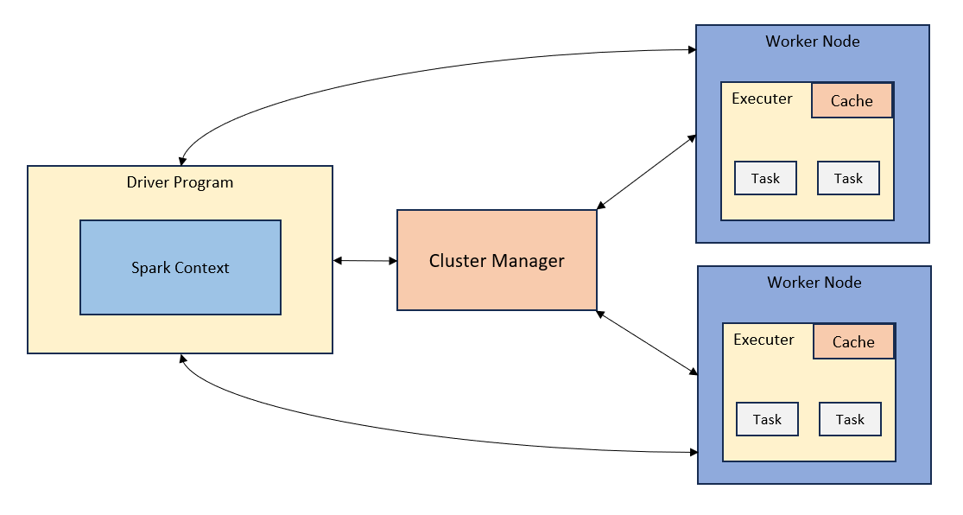
Apache Spark Architecture

Slide 15
The Spark follows the master-slave architecture. Its cluster consists of a single master and multiple slaves.
The Spark architecture depends upon two abstractions:
Resilient Distributed Dataset (RDD)
Directed Acyclic Graph (DAG)
Resilient Distributed Datasets (RDD)
The Resilient Distributed Datasets are the group of data items that can be stored in-memory on worker nodes. Here,
Resilient: Restore the data on failure.
Distributed: Data is distributed among different nodes.
Dataset: Group of data.
Directed Acyclic Graph (DAG)
Directed Acyclic Graph is a finite direct graph that performs a sequence of computations on data. Each node is an RDD partition, and the edge is a transformation on top of data. Here, the graph refers the navigation whereas directed and acyclic refers to how it is done.

Slide 16
Driver Program
The Driver Program is a process that runs the main() function of the application and creates the SparkContext object. The purpose of SparkContext is to coordinate the spark applications, running as independent sets of processes on a cluster.
Cluster Manager
The role of the cluster manager is to allocate resources across applications. The Spark is capable enough of running on a large number of clusters.
It consists of various types of cluster managers such as Hadoop YARN, Apache Mesos and Standalone Scheduler.
Worker Node
The worker node is a slave node
It’s role is to run the application code in the cluster.
Executor
An executor is a process launched for an application on a worker node.
It runs tasks and keeps data in memory or disk storage across them.

Slide 17
Python and Scala
Python language is a high-level, interpreted object-oriented programming language widely used for developing applications in various domains. It was created by Guido van Rossum in the late 1980s and has since become one of the most popular languages in the world. Python’s syntax is easy to read and learn, making it an excellent language for beginners. It has a vast standard library and many third-party modules that make it useful for a wide range of tasks, including web development, scientific computing, data engineering, and artificial intelligence. Python language is open-source and runs on multiple platforms, including Windows, macOS, and Linux.
Scala is a modern, multi-paradigm programming language designed to run on the Java Virtual Machine (JVM). It was created in 2003 by Martin Odersky and has gained popularity in recent years due to its functional programming capabilities, concise syntax, and powerful type system. Scala combines object-oriented and functional programming paradigms, allowing developers to write concise, expressive, highly scalable, and performant code. It is commonly used for building large-scale, distributed systems, web applications, and data processing applications. Scala also has interoperability with Java, allowing developers to use existing Java libraries and tools within Scala applications.

Slide 18

Basic Spark Commands
Creation of Array: To create an array of values Array() function is used.
Parallelizing Data: To distribute a collection of data across nodes of a Spark Cluster. This operation is essential for enabling parallel processing of data in a distributed computing environment.
Mapping: To apply specified function to each and every element of an RDD.

Slide 19

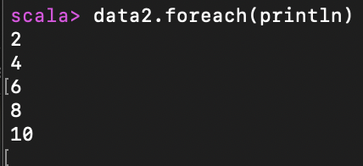
Basic Spark Commands
Filter Command: To selectively retain elements of an RDD based on a specified condition. To narrow down the dataset this command is used.
Collect Function: To retrieve all the elements of an RDD or a Distributed collection and bring them to the Driver program. It returns the elements as an array in the Drivers memory.
Foreach(): Applies specific function to each and every element in RDD. And this is often used for Printing, Saving to an external storage system.

Slide 20
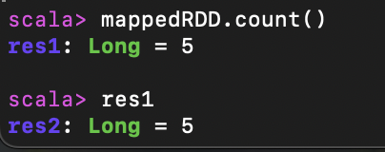

Basic Spark Commands
Count Command: To fetch the number of elements in RDD count() function is used.
Cache Command: For faster access to the data across multiple Spark actions or transformations. Caching an RDD is particularly useful when the RDD is reused multiple times in your Spark application, as it avoids recomputing the RDD's content each time it is needed.
Printing First Element: first() function is used to fetch the initial element of RDD.

Slide 21
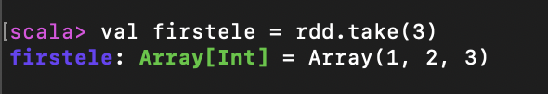
Basic Spark Commands
Print First N elements: take(N) function used to print first specified number of elements from an RDD. Returns them as an array to the driver program.

